Slide 1
Lecture 2
Agents and Problem Solving
Yaohang Li
Department of Computer Science
ODU
Reading for Next Class:
Chapter 3, Russell and Norvig

Slide 2
Review
Last Class
  agents perceive and act in an environment
    Definition of Percept
    Description of the environment (PEAS)
  ideal agents maximize their performance measure
    Rationality
  basic agent types
    simple reflex
    reflex with state
    goal-based
    utility-based
    learning
This Class
  Problem Solving Agent
Next Class
  Searching Algorithms
  Assignment 1

Slide 3
Review: Intelligent Agent
Agent: Definition
  Any entity that perceives its environment through sensors and acts upon that environment through effectors(actuators)
  Examples (class discussion): human, robotic, software agents
Perception
  Signal from environment
  May exceed sensory capacity
Sensors
  Acquires percepts
  Possible limitations
Action
  Attempts to affect environment
  Usually exceeds actuator capacity
Effectors (actuators)
  Transmits actions
  Possible limitations
Percepts
Sensors
?
Environment
Agent
Actions
Effectors

Slide 4
Agents
Rational Agents
Performance Measure
  Goal
Agent Environment
  fully observable vs. partially observable
  deterministic vs. stochastic (non-deterministic)
  episodic vs. sequential (non-episodic)
  static vs. dynamic
  discrete vs. continuous
  single vs. multiple agents
Agent Description
  PEAS
  PAGE

Slide 5
Problem-Solving Agents:
Definition
Problem-solving Agent
  Goal-based Agent
  Decide what to do by finding sequences of actions that lead to desirable states
Justification
  Rational Intelligent Agent
    act to reach environment that maximizes performance measure
Mechanism
  Define a “goal”
  Constitute a “problem”
  Search for a “solution”
Practical Issues
  Hard to find appropriate sequence of states
  Difficult to translate into agent design

Slide 6
Problem-solving Agent
Preliminary Design
Goal Formulation
  Goal
    Helps to organize the behavior of an agent by limiting the objectives that the agent is trying to achieve
  Formulations
    States
      Goal test is satisfied
  First step in problem solving: formulation of goal(s) – “accept no substitutes”
  Based on
    the current situation
    agent’s performance measure
Problem Formulation
  To decide what actions and states to consider, given a goal
  Given: initial state, desired goal, specification of actions
  Find: achievable sequence of states (actions) mapping from initial to goal state
Search
  Actions: cause transitions between states
  Typically specified in terms of finding sequence of states

Slide 7
Problem-Solving Agents:
Specification
Input: Informal Objectives; Initial, Intermediate, Goal States; Actions
Output
  Path from initial to goal state
  Leads to design requirements for state space search problem
Logical Requirements
  States: representation of state of world (example: starting city, graph representation of Romanian map)
  Operators: descriptors of possible actions (example: moving to adjacent city)
  Goal test: state → boolean (example: at destination city?)
  Path cost: based on search, action costs (example: number of edges traversed)
Operational Requirements
  Search algorithm to find path
Environment
  Agent can search in environment according to specifications
  Sometimes has full state and action descriptors; sometimes not!

Slide 8
Solution
Solution
  A path from the initial state to a goal state
  A problem may have more than one solutions
Optimal Solution
  Has the lowest path cost among all solutions

Slide 9
Well-defined Problems
A Problem can be defined by four components
  The initial state
    The agent starts in
  Actions
    A description of the possible operations available to the agent
    State space
      Forms a graph
      Nodes
        States
      Arcs
        Actions
  Goal test
    Determines whether a given state is a goal state
  A path cost function
    Assigns a numeric cost to each path
    Step cost
      Cost of each action

Slide 10
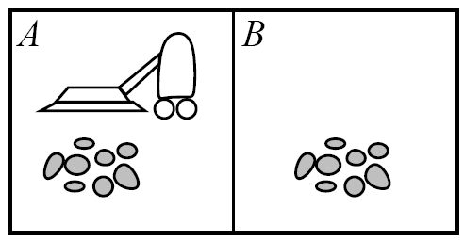
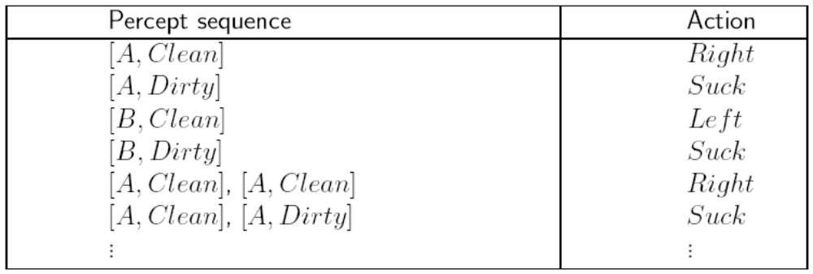
Vacuum-Cleaner World

Slide 11
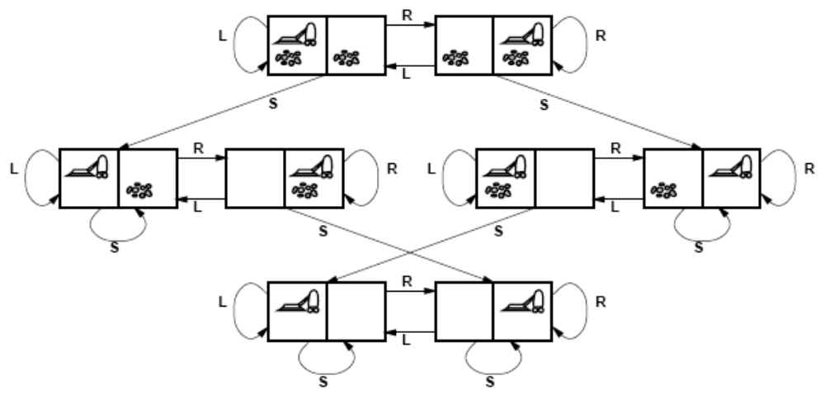
Example: Vacuum-cleaner World
States: Integer Dirt and Robot Location (Ignore the Dirt Amount)
Actions: Left, Right, Suck
Goal: No Dirt
Path Cost: 1 per move

Slide 12
Good Representation
Good Representations to a Problem are the Key to Good Problem Solving
Example
  The Farmer, Fox, Goose, and Grain
  Description
  A farmer wants to move himself, a silver fox, a fat goose, and some tasty grain across a river. Unfortunately, his boat is so tiny he can take only one of his possessions across on any trip. Worse yet, an unattended fox will eat a goose, and an unattended goose will eat grain, so the farmer must not leave the fox alone with the goose or the goose alone with the grain. What is he to do?

Slide 13
Problem Formulation for the Farmer Problem
States
  A state description specifies the location of the farmer, fox, goose, and grain
Initial State
  Farmer, fox, goose, and grain are at one side of the river
Successor function
  Farmer moves along with one of the three (fox, goose, grain) to the other side of the river
Goal test
  Farmer, fox, goose, and grain are at the other side of the river
Path test
  Each step costs 1
  The path cost is the number of steps in the path

Slide 14
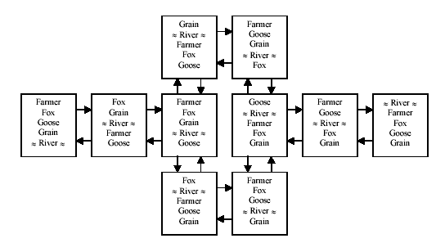
Problem Formulation

Slide 15
Representation Principle
Once a problem is formulated using an appropriate representation, the problem is almost solved.

Slide 16
Problem-Solving Agents:
Implementation
function Simple-Problem-Solving-Agent (p: percept) returns a: action
  inputs: p, percept
  static: s, action sequence (initially empty) state, description of current world state g, goal (initially null) problem, problem formulation
  state ← Update-State (state, p)
  if s.Is-Empty() then
    g ← Formulate-Goal (state)
    problem ← Formulate-Problem (state, g)
    s ← Search (problem)
  action ← Recommendation (s, state)
  s ← Remainder (s, state)
  return (action)

Slide 17
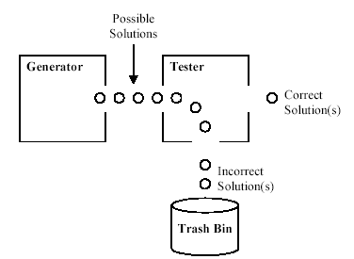
Solving A Problem

Slide 18
Example Toy Problem: 8-puzzle
8
2
1
2
3
3
4
7
4
5
6
5
1
6
7
8
Initial state
Goal state

Slide 19
Example Toy Problems – 8 puzzle problems
states
  location of tiles (including blank tile)
initial state
  any legitimate configuration
successor function (operators)
  move tile
  alternatively: move blank
goal test
  any legitimate configuration of tiles
path cost
  one unit per move

Slide 20
Example: 8-puzzle
Size of the state space = 9!/2 = 181,440
15-puzzle → .65 x 10¹²
24-puzzle → .5 x 10²⁵
0.18 sec
6 days
12 billion years
10 millions states/sec

Slide 21
Real-World Problems
Route Finding
  Objectives (informal): finding shortest path for situated agent – exploration cost
  States: graph representation
  Operators: move from location to location; other degrees of freedom (navigation)
  Goal test: “are we there yet?”; “did we get there in time?”; “found target?”
Traveling Salesperson Problems (TSP) and Other Touring Problems
  Hamiltonian tour
  Objectives (informal): finding shortest cost tour that visits all v ∈ V exactly once
  States: current location in V of agent
  Operators: visit a neighbor (constraint: previously unvisited)
  Goal test: “Is the tour the minimum?”
Other
  Very Large-Scale Integrated (VLSI) circuit layout
  Robot navigation
  Assembly sequencing (possible real-time scheduling application)

Slide 22
Simple Agent Algorithm
Problem-Solving-Agent
initial-state ← sense/read state
goal ← select/read goal
successor ← select/read action models
problem ← (initial-state, goal, successor)
solution ← search(problem)
perform(solution)

Slide 23
Concepts in Data Structure and Algorithm
Data structure
  Tree
    Node
    Parent
    Children
    Leaf node
  Graph
    Node
    Arc
  Stack
  Queue

Slide 24
Search Terminology
Search
  The process of looking for a sequence of actions that can start from the initial state and arrive in the goal state
Solution
  This sequence of actions (path) is called a solution
Optimal Solution
  Has the lowest cost among all the solutions
Execution
  Carry out the actions specified by the solution

Slide 25
Blind Search vs. Heuristic Search
Uninformed search (Blind Search)
  No additional information about states beyond that provided in the problem definition
Informed search (Heuristic Search)
  Know whether one non-goal state is “more promising” than another

Slide 26
Example: 8-puzzle
For a blind strategy, N1
and N2 are just two nodes
(at some depth in the search
tree)
For a heuristic strategy
counting the number of
misplaced tiles, N2 is more
promising than N1
8
2
3
4
7
STATE
N1
5
1
6
1
2
3
1
2
3
4
5
6
4
5
STATE
7
8
N2
7
8
6
Goal state

Slide 27
Fringe
Set of search nodes that have not been expanded yet
Implemented as a queue FRINGE
  INSERT(node,FRINGE)
  REMOVE(FRINGE)
The ordering of the nodes in FRINGE defines the search strategy

Slide 28
Basic Search Concepts
Search tree
  generated as the search space is traversed
    the search space itself is not necessarily a tree, frequently it is a graph
    the tree specifies possible paths through the search space
  expansion of nodes
    as states are explored, the corresponding nodes are expanded by applying the successor function
      this generates a new set of (child) nodes
    the fringe (frontier) is the set of nodes not yet visited
      newly generated nodes are added to the fringe
  search strategy
    determines the selection of the next node to be expanded
    can be achieved by ordering the nodes in the fringe
      e.g. queue (FIFO), stack (LIFO), “best” node w.r.t. some measure (cost)
Search node
  Corresponding to a state in the state space
Search strategy: At each stage it determines which node to expand

Slide 29
Search Nodes ≠ States
8
2
3
4
7
5
1
6
8
2
7
The search tree may be infinite even
when the state space is finite
3
4
5
1
6
8
2
8
2
8
4
2
8
2
3
4
7
3
4
7
3
7
3
4
7
5
1
6
5
1
6
5
1
6
5
1
6

Slide 30
Node Data Structure
STATE
  The state in the state space to which the node corresponds
PARENT-NODE
  The node in the search tree that generated this node
ACTION
  The action that was applied to the parent to generate the node
PATH-COST
  The cost, traditionally denoted by g(n), of the path from initial state to the node, as indicated by the parent pointers
DEPTH
  The number of steps along the path from the initial state

Slide 31
Searching for Solutions
traversal of the search space
  from the initial state to a goal state
  legal sequence of actions as defined by successor function (operators)
general procedure
  check for goal state
  expand the current state
    determine the set of reachable states
    return “failure” if the set is empty
  select one from the set of reachable states
  move to the selected state
a search tree is generated
  nodes are added as more states are visited

Slide 32
Measuring problem-solving performance
Completeness
  Is the algorithm guaranteed to find a solution when there is one?
Optimality
  Does the strategy find the optimal solution?
Time Complexity
  How long does it take to find a solution?
Space Complexity
  How much memory is needed to perform the search?

Slide 33
Uninformed Search
Breadth-first
  Bidirectional
Depth-first
  Depth-limited
  Iterative deepening
Uniform-Cost

Slide 34
Breadth-first search
Search Strategy
  The root node is expanded first
  then all the successors of the root node are expanded next
  then their successors, and so on
Procedure
  1. Apply all possible operators (successor function) to the start node.
  2. Apply all possible operators to all the direct successors of the start node.
  3. Apply all possible operators to their successors till goad node found

Slide 35

Bread-First Search

Slide 36
Depth-first Search
Strategy
  Always expands the deepest node
Procedure
  Start from the initial node
  Explore a successor node at the next level
  Until reach the leaf, then “back up” to the next “shallower” node that still has unexplored successors

Slide 37
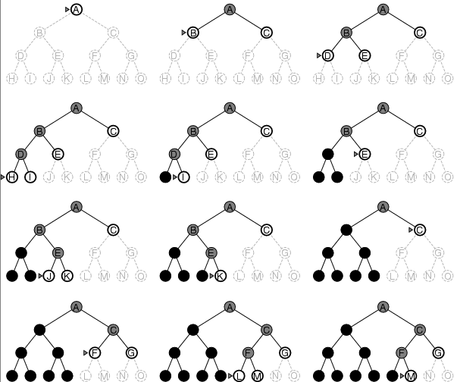
Depth-First Search Example

Slide 38
Summary
Problem-solving Agent
Goal Formulation
Problem Formulation
Solving
Important AI problems
Search Terminology
Measuring Search Algorithms
Uninformed Search
  Breadth-first search
  Depth-first search

Slide 39
What I want you to do
Review Chapter 3
Organize your project team

